Slide 1
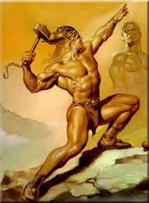
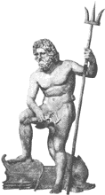
By Sam Francis
Roman Gods and Goddesses

Slide 2
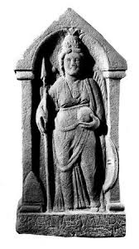
Introduction
The Romans believed in many different gods and goddesses. For anything they had a god or goddess in charge. The Romans had hundreds of different gods and goddesses. Here are some of them.

Slide 3
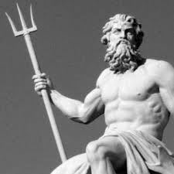
Gods
First, I am going to show you four gods, Don’t worry. After I show you the gods, I will show you the goddesses.
Here is a Roman god

Slide 4
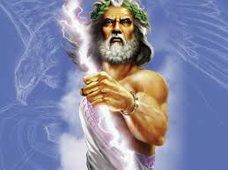
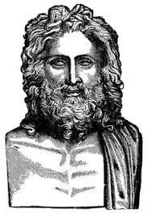
Jupiter
Jupiter was a Roman God. Jupiter was the main god of the Romans. In his hand he held thunderbolts which he could hurl from the sky.

Slide 5
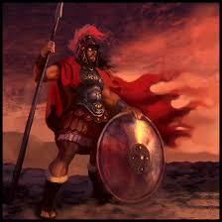
Mars
Mars was the god of war, He was the most strongest and fearsome god apart from Jupiter. Mars was Jupiter's son. Nobody liked Mars.

Slide 6
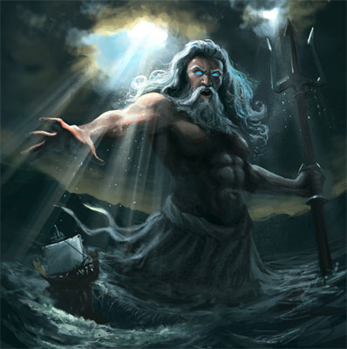
Neptune
Neptune was the powerful god of the sea. His symbol was the trident. He was a very powerful god. Neptune was the brother of Jupiter.

Slide 7
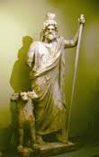
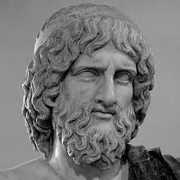
Pluto
Pluto was the god of the underworld. He was a brother of Jupiter. A bit like Neptune, who was another brother of Jupiter.

Slide 8
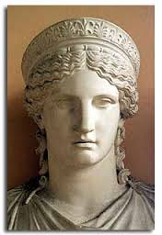
Goddesses
Now I am going to show you the goddesses. I hope you enjoyed seeing my gods. Here are some goddesses.
Here is a picture of a goddess

Slide 9
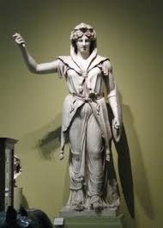
Juno
Juno was Jupiter's wife. She was the goddess of women and fertility. Her symbols were a peacock and a pomegranate.

Slide 10
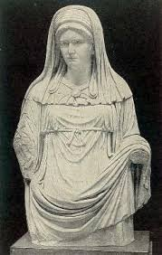
Vesta
Vesta was the goddess of hearth and home. She was extremely important to the Romans. In Vesta’s temple, there was a flame that was burning all the time.

Slide 11
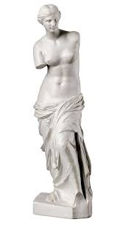
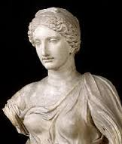
Venus
Venus was the goddess of love and beauty.

Slide 12
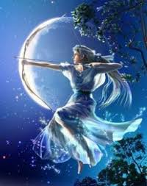
Diana
Diana was the Goddess of hunting. She was also the Goddess of the moon.

Slide 13

Thanks for watching
Thank you for watching my PowerPoint presentation. I hope you enjoyed it.

